Slide 1
Food Delivery Service Database
Eimear Quinlan
Liam Walsh

Slide 2
Why We Chose Food Delivery
Industry which relies on accurate data retrieval to ensure success
Each database entry has lots of data associated with it
Especially applicable in the current day

Slide 3
Schema Breakdown
Customer
Primary Key: CustomerID
Fname, Lname, Phone, Address
Driver
Primary Key: DriverID
Fname, Lname, Phone, LicenseNum
Restaurant
Primary key: RestaurantID
Street, Town, State, FoodType, Name

Slide 4
Schema Breakdown cont.
Car
Primary Key: CarDriverID, CarID
Plate, Type
FoodOrder
Primary Key: OrderCustomerID, OrderRestaurantID, OrderDriverID, OrderID
OrderTime, Items, Price
Payment
Primary key: PaymentCustoemrID
Bank, CardNum
Foreign Key: CarDriverID
Foreign Key: OrderCustomerID, OrderRestaurantID, OrderDriverID
Foreign Key: PaymentCustomerID

Slide 5
Schema Breakdown cont.
Tip, TimeEst
Foreign Key: DeliverCustomerID, DeliverDriverID
Primary Key: DeliverCustomerID, DeliverDriverID
Delivers_To

Slide 6
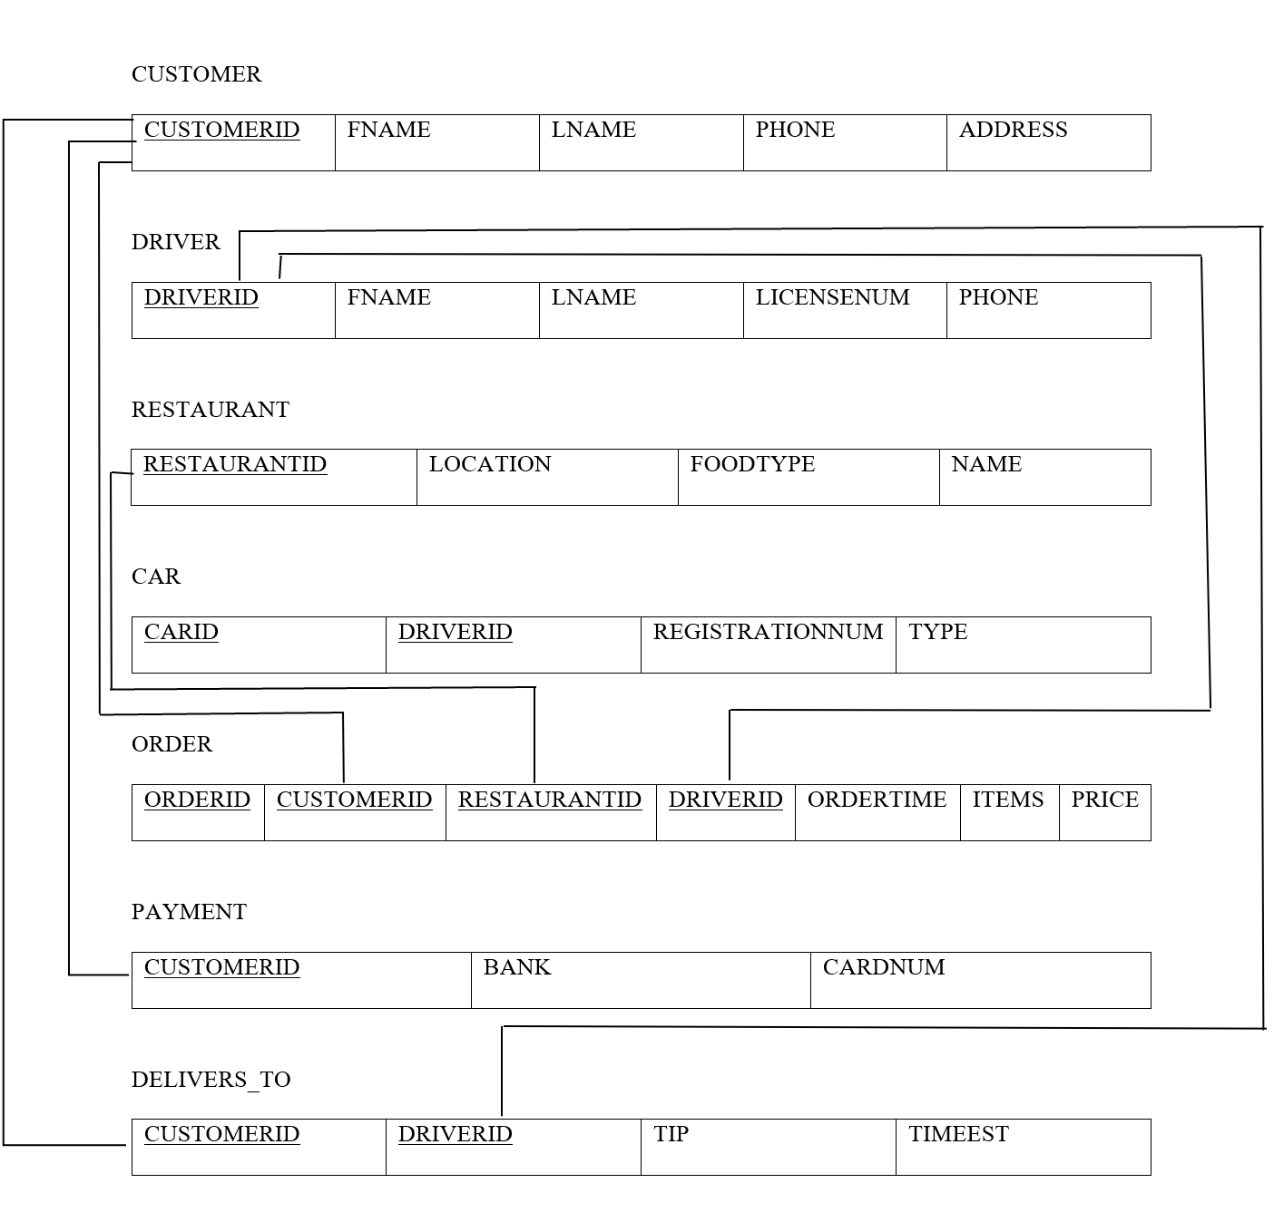
Schema

Slide 7
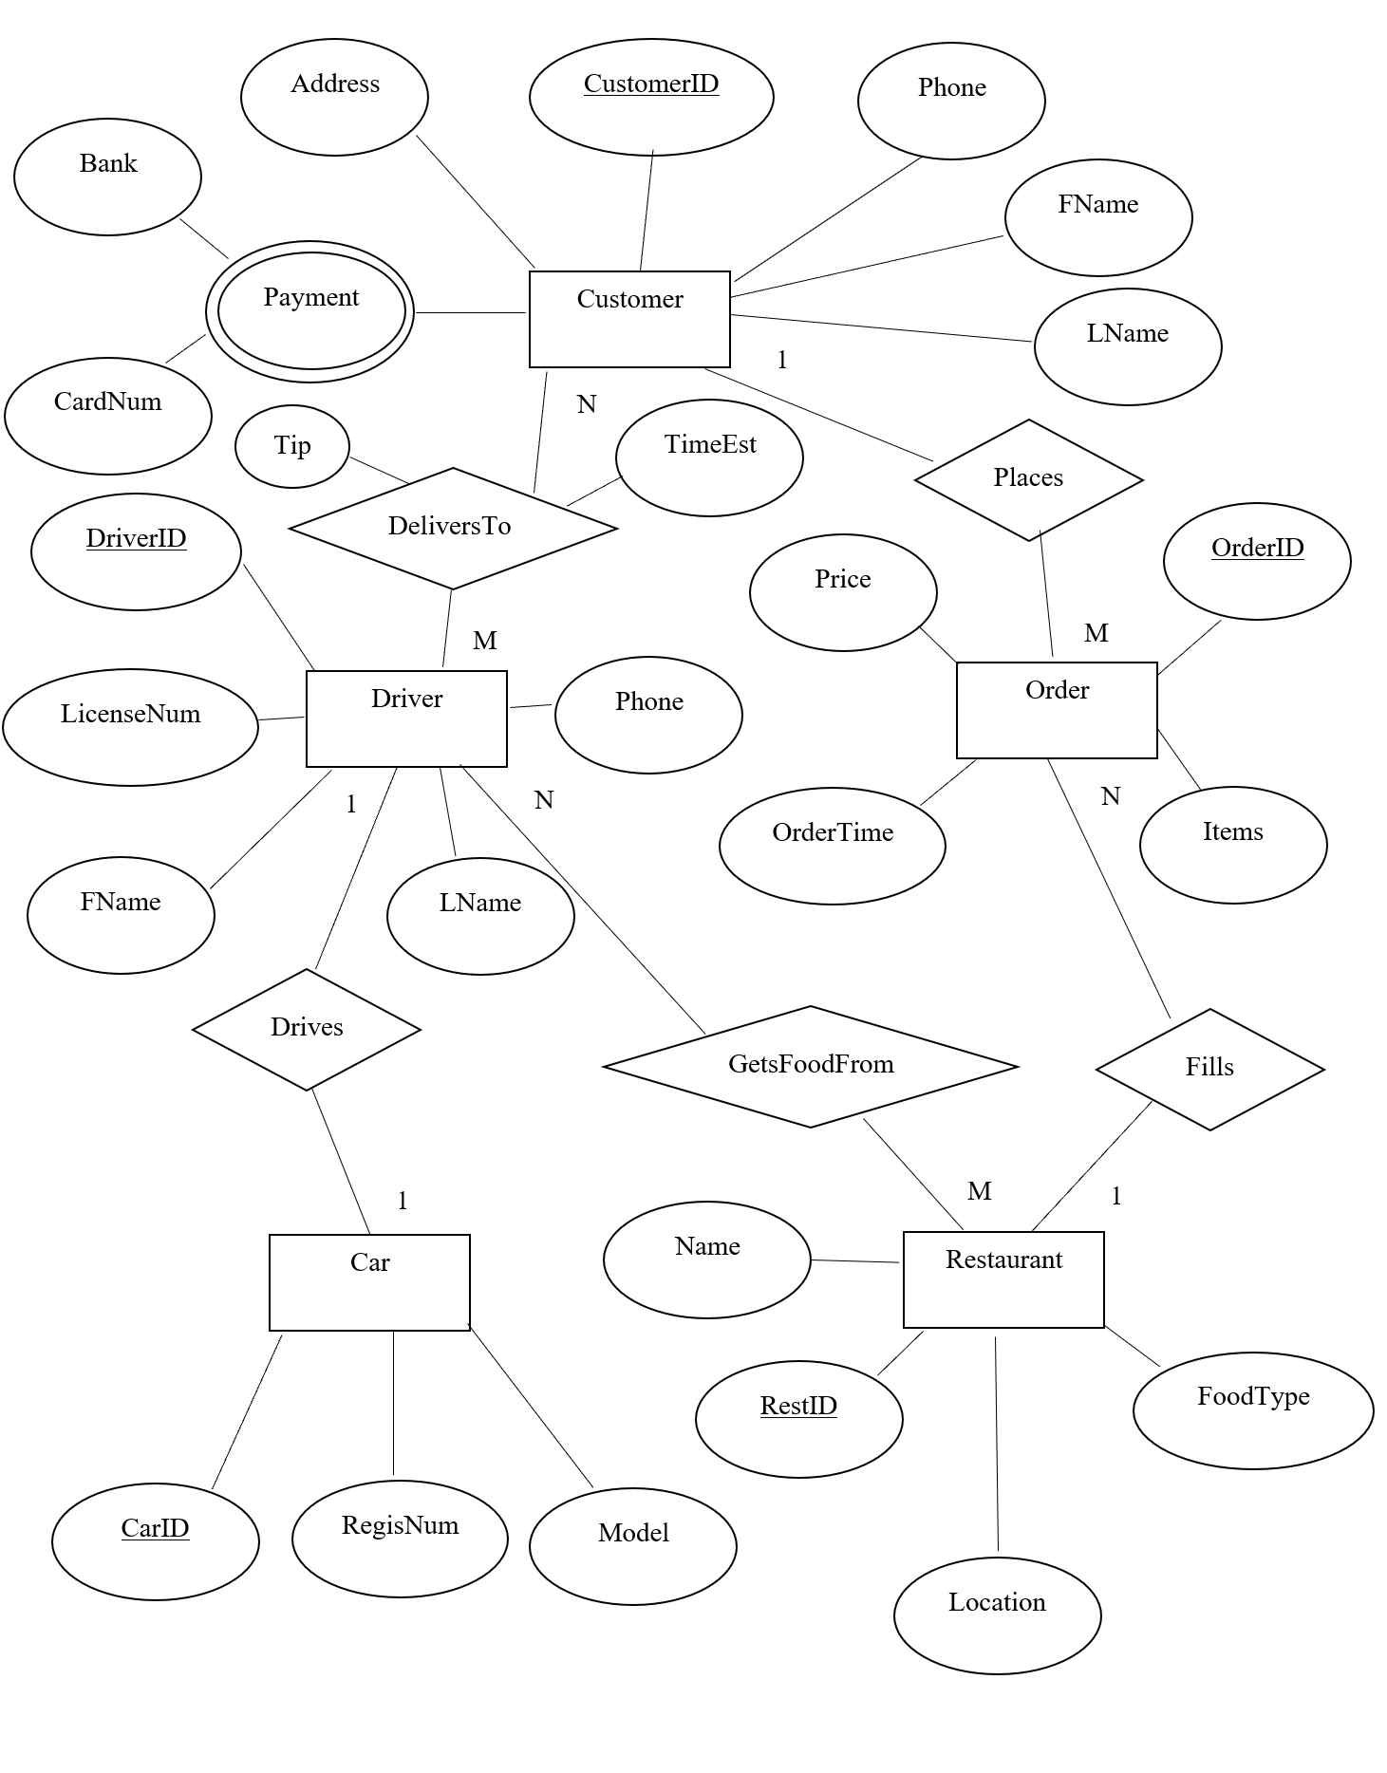
ER Diagram

Slide 8
Business Rules
Each driver can deliver to many customers, and each customer can receive items from multiple drivers.
Each driver only drives one car that is unique to them.
Each customer can place multiple orders, but each order is only for one customer.

Slide 9
Business Rules cont.
Each order can have items from only one restaurant, but each restaurant can process multiple orders.
Each driver can get an order from multiple restaurants, and each restaurant can give orders to multiple drivers.

Slide 10
Schema Breakdown cont.
Real restaurant data from around Villanova
Names, addresses, and food types are taken from restaurants within delivery distance of Villanova
Created but true to reality data for all other sections
Proper length of license number, license plate, card number, etc. to make data similar to real life

Slide 11
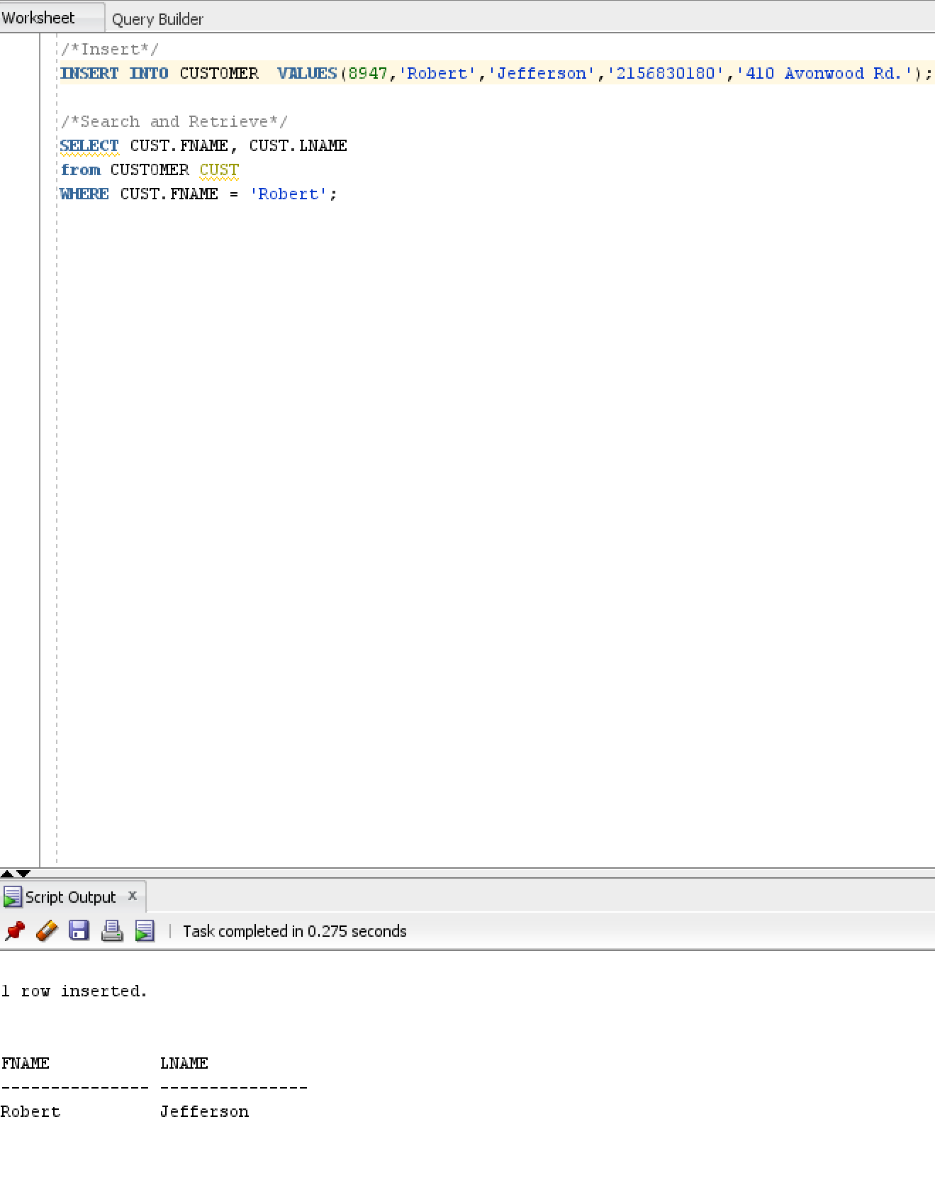
Functionality
Able to insert, search and retrieve records

Slide 12
Thank You for Watching!

